Slide 1

Classification of Machine Failure
Project No. 73

Slide 2
Team Name :Group 4
Team Members
Gokula Krishna
Sanket Dhole
Deepsandhya Shukla
Rooba Dharshini
ThamizholiAnandan
Dalmiya Candace Denzil
Mentor:Munmun Bhagat

Slide 3
BUSINESS OBJECTIVE
In industries, re-evaluating their maintenance schedules is necessary for this digitalization era as smart as possible for production enhancements. Predictive maintenance offers great opportunities to businesses for a smarter and more digital facility.
The objective of the analysis is to create a model to predict when the machine is more likely to fail.

Slide 4
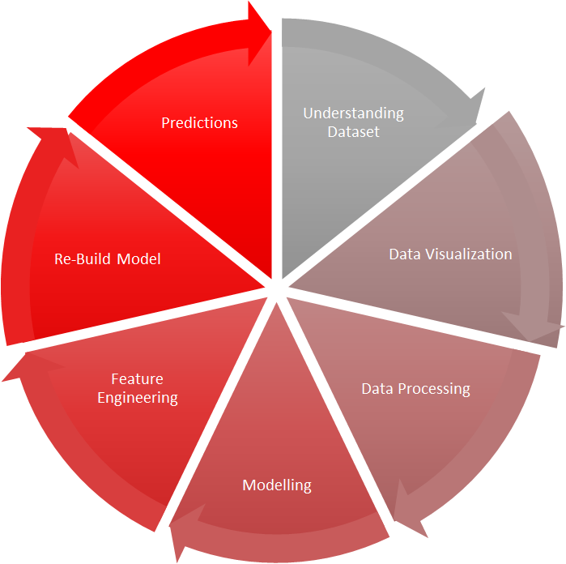
Process Flow

Slide 5
Inferences from given Data-Set
01
03
Dataset
Missing Value
10000 rows
14 columns
Data Types
Not present in the dataset
Duplicated rows
OBJECT
INTEGER
FLOAT64
No duplicate row
02
04

Slide 6
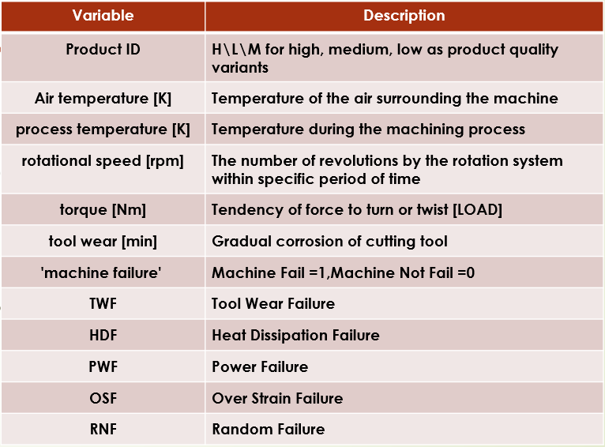
DATA VARIABLE DESCRIPTIONS

Slide 7
Data Set Details
01
Data Type
Object-Product ID, Type
Integer- UDI, Rotational speed [rpm], Tool wear [min], Tool wear [min], Machine failure, TWF,HDF, PWF, OSF, RNF
Float - Air temperature [K], Process temperature [K], Torque [Nm]
02
Encoding categorical Variables
Object Variables will be Treated post Analysis
03
Imbalanced DataSet
It was observed No failure was 9661 and failure was 339
N.B :For columns from Machine failure to random failures, left to right, we have samples in the form of 0 and 1. This ‘0’ and ‘1’ indicates No failure and failure of the machine respectively. The machine fails whenever any of the TWF, HDF, PWF, ODF, RNF fails.

Slide 8
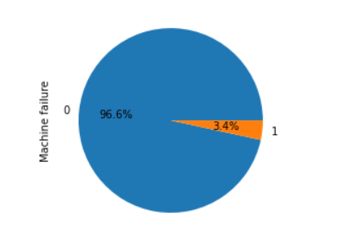
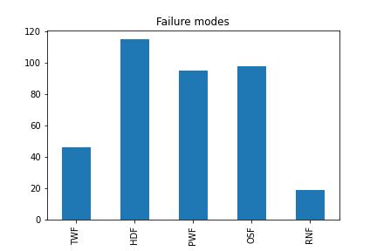
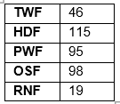
Exploratory data analysis
Visual interpretation of Machine failure and five independent failure modes

Slide 9
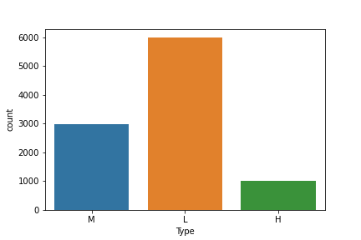
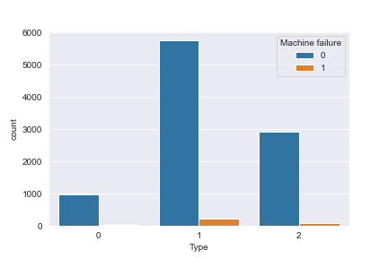
1.Product and machine failure count by their quality:
Inferences from Data Visualization
(a) We can understand that number of products by their product quality. There are products
1003 in high quality,
6000 in low quality,
2997 in medium quality.
(b) It shows the quality wise failures in product manufacturing. It helps to learn there are more failures in the low-quality product about 235 failures than rest together (H=21, M=83). Hence, they can ensure less failure during low quality product failure.
Quality wise failures in product

Slide 10
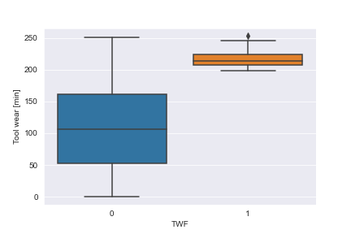
2.Failure by Tool Wear Failure:
We can understand that if the tool is used more than 200 minutes it will cause machine failure.
The machine has failed 46 times.
We will understand that use of tool should be less than 200 minutes, so failure can be avoided or reduced. This will help to reduce unexpected machine downtime and improve quality of product.
Graph for Tool Wear Failure.

Slide 11
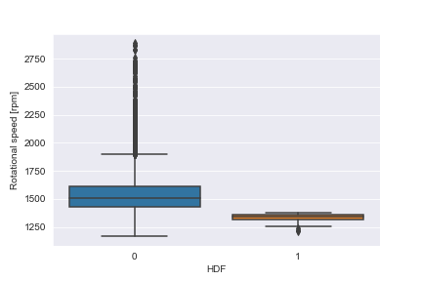
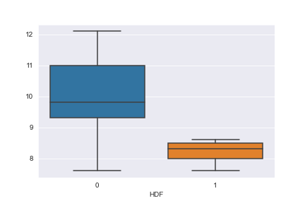
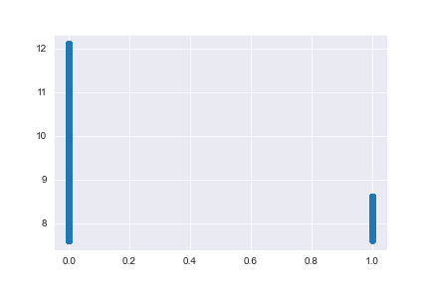
3.Heat dissipation failure:
In heat dissipation failure occurs because of two variables namely rotational speed and temperature difference which leads to machine failure.
The below graphs will can understand the failure of machine.
From fig (a), first when the rotational speed is below nearly 1400 rpm, and from fig (b)&(c) second when the temperature difference between air temperature and process temperature is below 9 K (or nearly 8.5 K from regression graph(c)).
There are 115 heat dissipation failure in the machine. We understand the working range of the machine, so they can ensure rotation speed and temperature difference in the working limits.
(a)
(b)
(c)
Graphs for heat dissipation failure

Slide 12
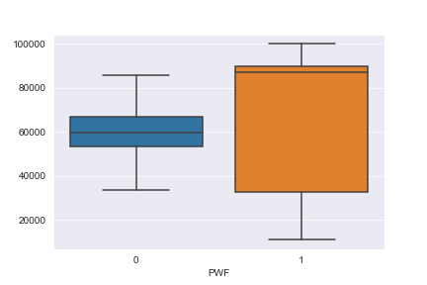
4. Power failure:
Machine has failed 95 time in total citing power failure reason.
From the figure , we can understand that the working range of power is approximately in between 35,000 watt and 90,000 watt.
If power value is not in limits, it will make machine fail. To avoid power failure we should keep machine power in between range.
Graph for Power Failure

Slide 13
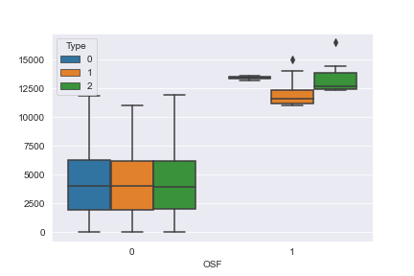
5.Over strain failure:
Over strain failure occurs when the product of tool wear and torque goes beyond limit.
From the fig. we can understand that; the over strain failure does not occur uniformly on every product but it is depending on Type of Quality.
The working range for all types is approximately same. The machine has failed 98 times because of overstrain failure.
For low quality product when the product of tool wear and torque goes beyond limit of approximately 11,000 Nm-min, for medium quality approximately 12,500 Nm-min and for high quality approximately 13,500 Nm-min. So we can keep product of tool wear and torque in specified limit for each quality of product to avoid overstain failure.
Overstain failure

Slide 14
6.Random Failure:
The random failure is not related to any kind of parameter. This failure occurs randomly and it is not depending on variable.

Slide 15
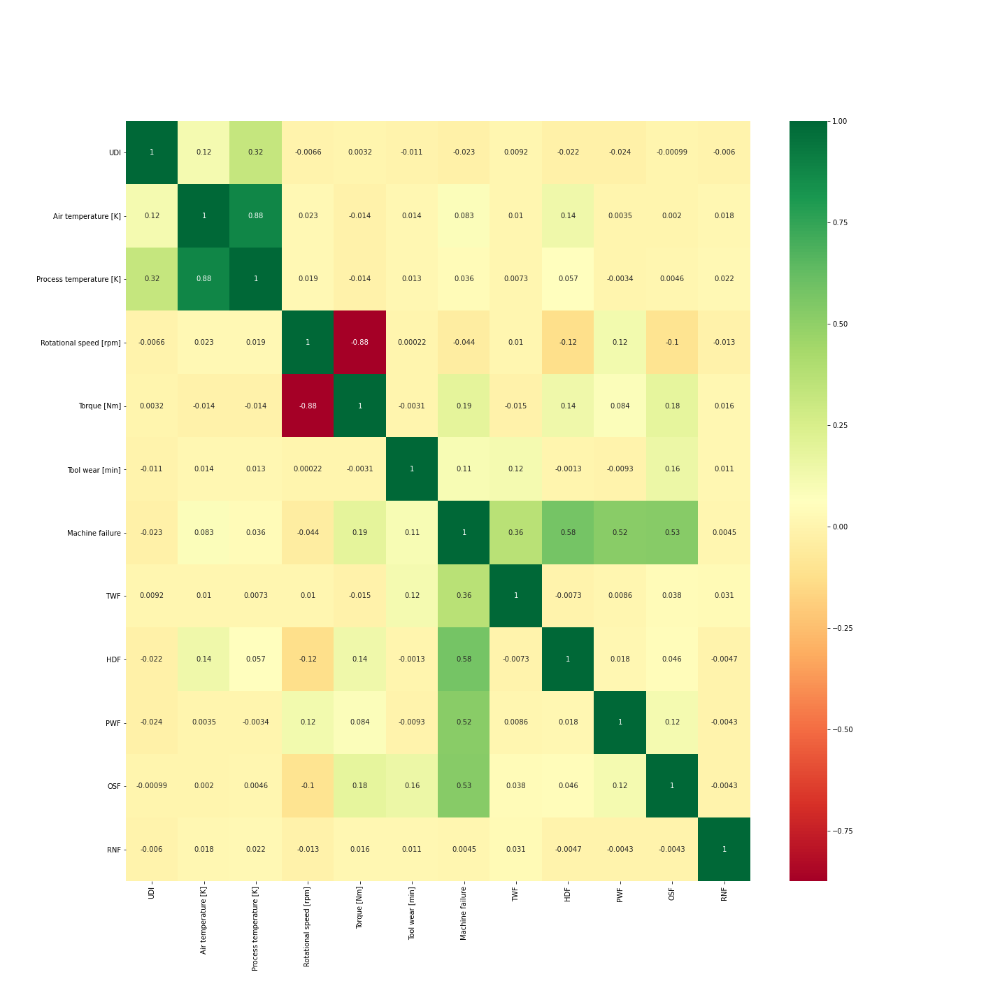
Heat Map
Heat Maps visualization helps us to identify the most correlated variables.
We can observe that the most correlate variables are (Air temperature — Process temperature) and (Rotational speed — Torque).

Slide 16


Data Processing
Encoding
To convert categorical variable to numerical we have treated with label encoding

Slide 17
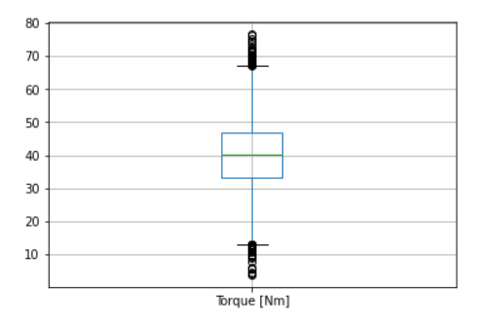
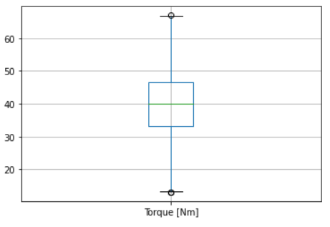
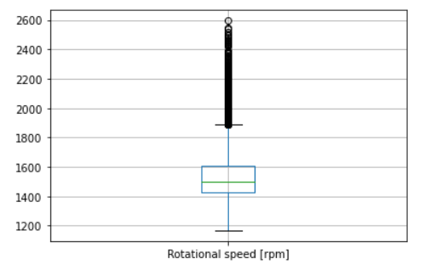
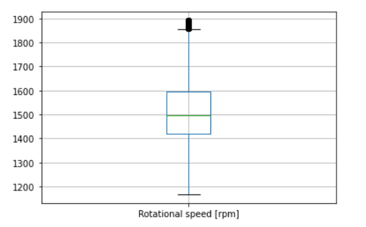
Outlier Correction
There is 87% correlation between the columns Rotational speed and Torque.
Rotational speed has more outlier than Torque .
Even after treating outlier the correlation is high, so we are deleting the column ‘Rotational speed’
Outlier correction before and after

Slide 18
Balancing the Dataset
As the dataset is imbalanced, we have performed upsampling on the data using SMOTE technique to balance the data.
 | No failure Count | Failure count
Before Upsampling | 9262 | 267
After Upsampling | 9262 | 9262

Slide 19
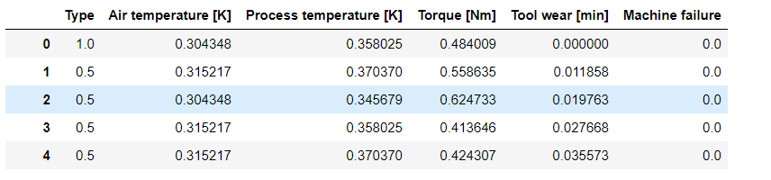
Normalization of the data
As the data is in different units we used MinMaxScaler to normalize the data

Slide 20
Splitting the data into test and train
The final data after data processing was split into test data and train data
 | X | Y
Train set | 14819 , 4 | 14819
Test set | 3705 , 4 | 3705

Slide 21
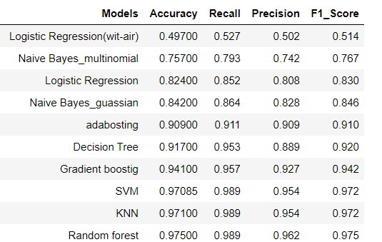
Model building

Slide 22
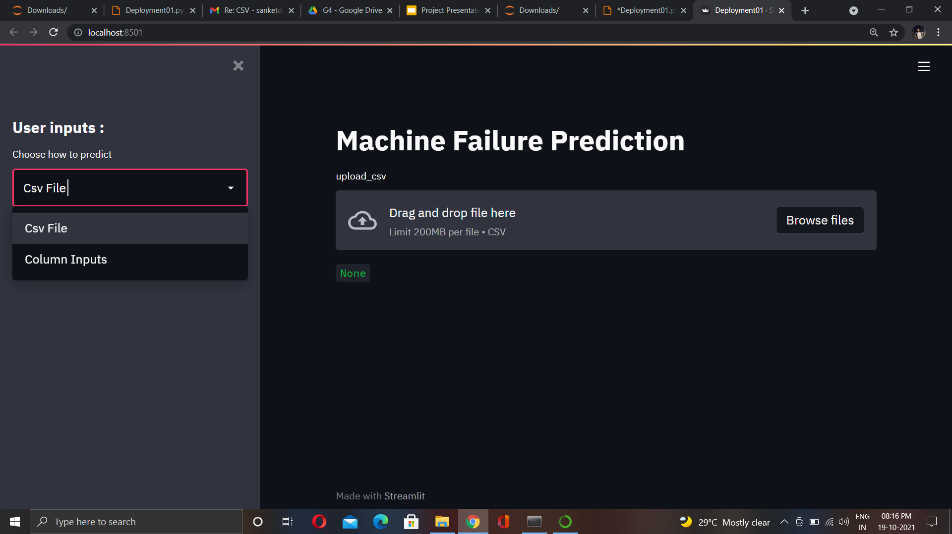
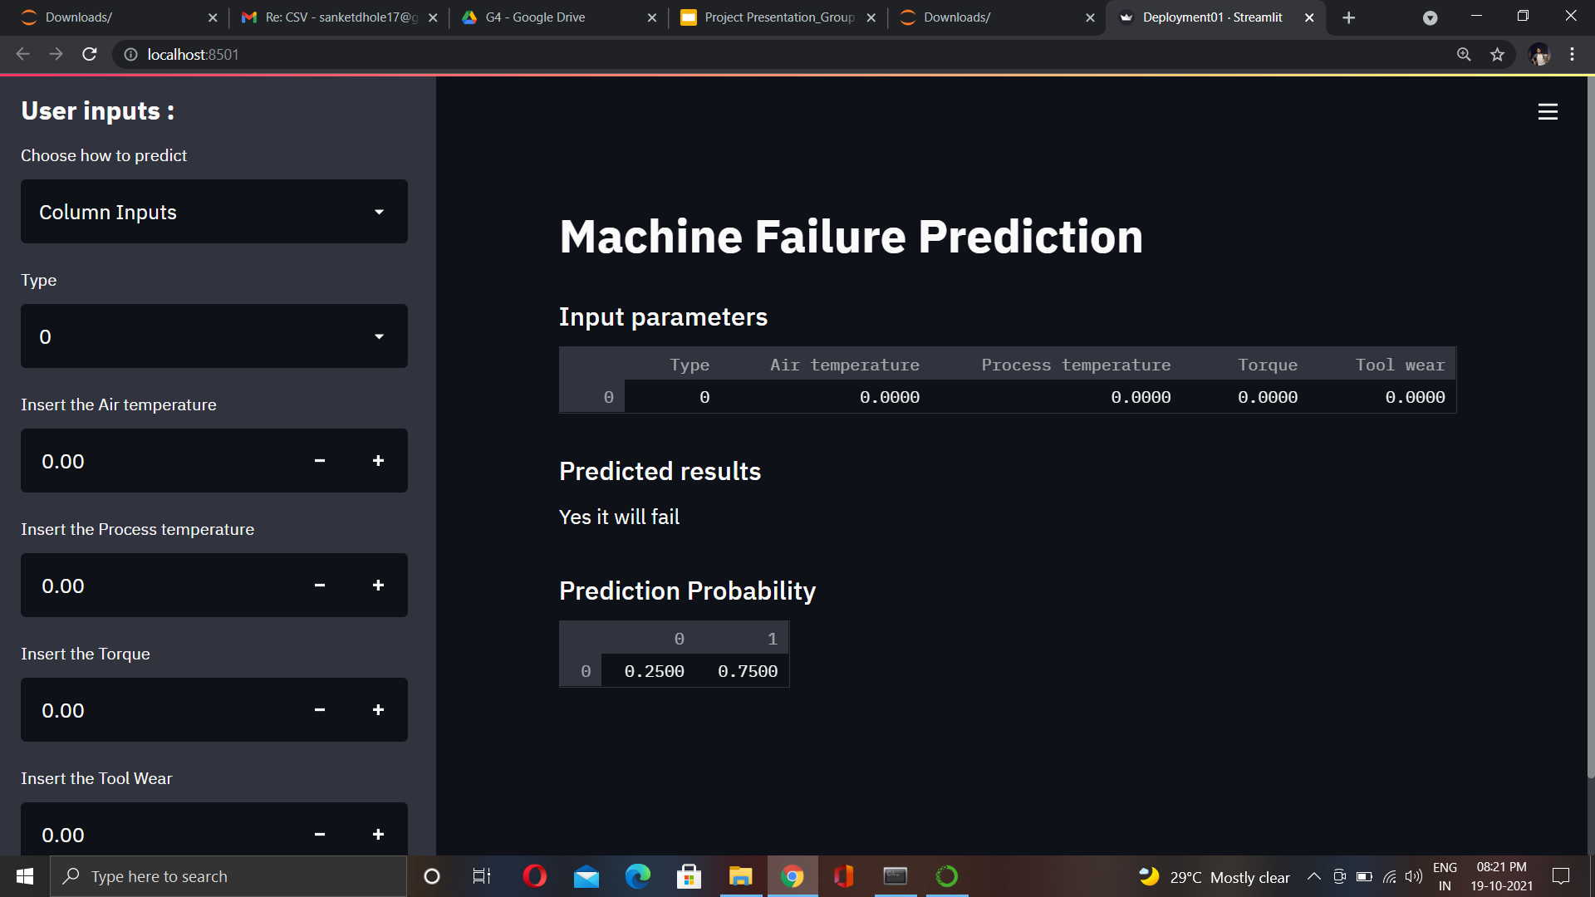
Model Deployment Using Streamlit

Slide 23
CHALLENGES FACED
Imbalanced Dataset
Outlier Detection
CHALLENGES
Feature Selection
Increasing Model accuracy

Slide 24
CONCLUSION AND IMPROVEMENTS
It can be inferred that on the whole a Random Forest Model provides the best result in terms of accuracy as well as the recall rate for the given dataset.
Deleting the Rotational speed and the sub failure columns has helped improve the model accuracy.
Upsampling and balancing the data is definitely required to get a good result on the final model.
Outliers in the data have been removed for better accuracy.
In spite of high correlation between air temperature and process temperature columns, keeping both the columns is giving good results.
Categorical values have been converted to numerical.
Since the data was in different units, normalization has been performed on the data.
The above improvements have helped in getting a good accuracy for the final model.

Slide 25
Thank You

